Slide 1



Cut in detection
S B Pranav Sumesh - 220051601091
Bhuvanesh S - 220051601023
Mohammed Khashif Khan - 230051601069
- Under the Guidance of
Dr . V. Jean Shilpa
Associate Professor

Slide 2
Problem Statement
A vehicle cut-in occurs when another vehicle enters the lane directly in front of your vehicle, typically with minimal space and often without signaling.
Cut-ins pose a significant risk of collision, especially if the cut-in vehicle merges abruptly or at high speed, requiring quick reaction from the driver.
Drivers must react swiftly to cut-ins by adjusting speed, increasing following distance, or changing lanes to maintain safety and avoid accidents.
Cut-ins can happen due to various reasons, including distracted driving, misjudgment of gaps in traffic, aggressive driving behavior, or sudden lane changes by other drivers.
Detection Accuracy
Real-time Performance
Achieve high precision and recall rates in identifying cut-in events using sensor data (e.g., camera, radar, lidar).
: Ensure the algorithm operates efficiently with minimal latency, suitable for real-time decision-making in AVs.
Achieve high precision and recall rates in identifying cut-in events using sensor data

Slide 3
Unique Idea
YOLOv8-based Python code excels in detecting diverse vehicles on congested Indian roads.
Challenges include identifying bicycles, motorcycles, auto-rickshaws, cars, and buses.
The algorithm distinguishes vehicles amidst cluttered backgrounds with high accuracy.
Training with a comprehensive dataset ensures effective real-time detection and categorization.
Enables efficient traffic monitoring and management in dynamic Indian road conditions.

Slide 4
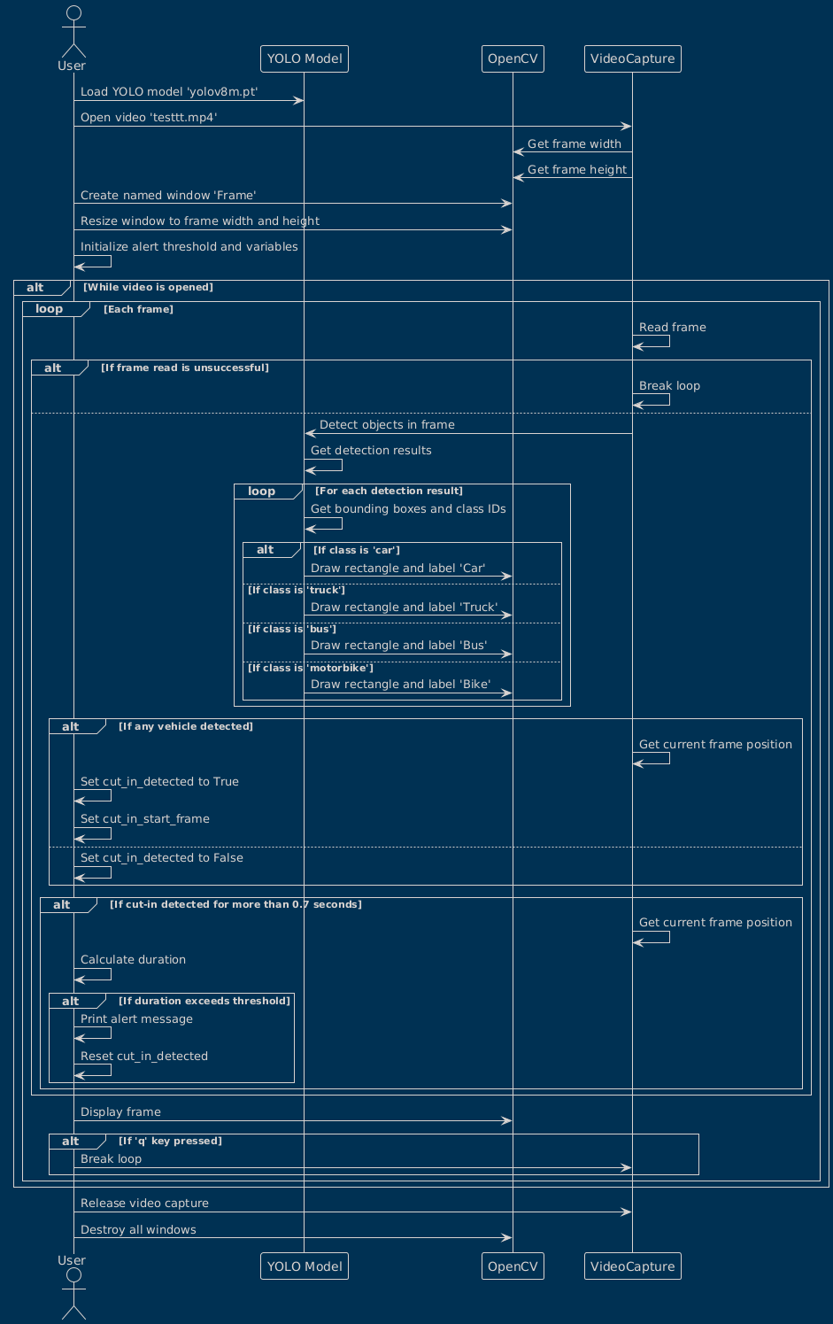
Process Flow

Slide 5
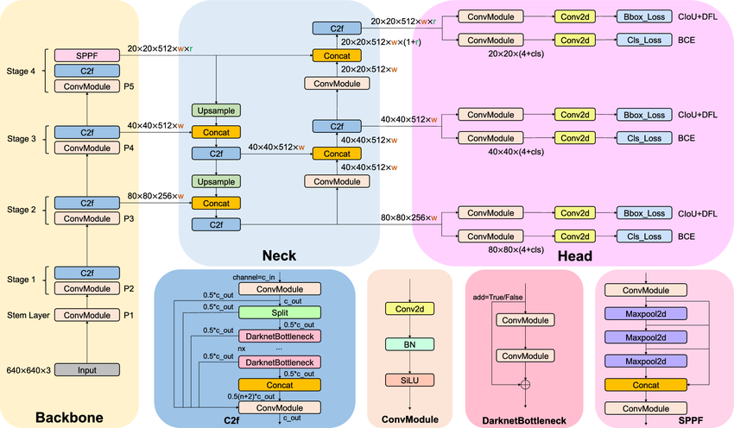
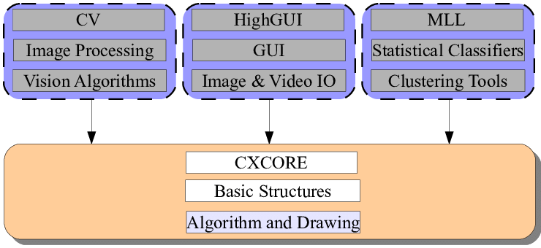
Process Flow
Architecture Diagram
YOLOV8
OPENCV

Slide 6
Process Flow
Technology used
YOLOV8
OpenCV
Python 3.12.3

Slide 7
Process Flow
Architecture Diagram
Technology used
Team Members and contribution
S B Pranav Sumesh - 220051601091
Bhuvanesh S - 220051601023
Khasif Khan - 230051601069
R&D:This part plays a crucial role is understanding the concept of the problem statement and we as a team decided to allocate weeks in doing the R&D for vehicle cut-in detection.
After completing the R&D part of the development we split our works accordingly, the team lead (Bhuvanesh) came up with the idea of using yolo as a base for training the model.
As rookies we were unable to train a model from scratch so we decided to use pretrained weights from official yolo developers.
The teammates played a crucial role in stabilizing the code error free and get a solid output from the trained model.

Slide 8
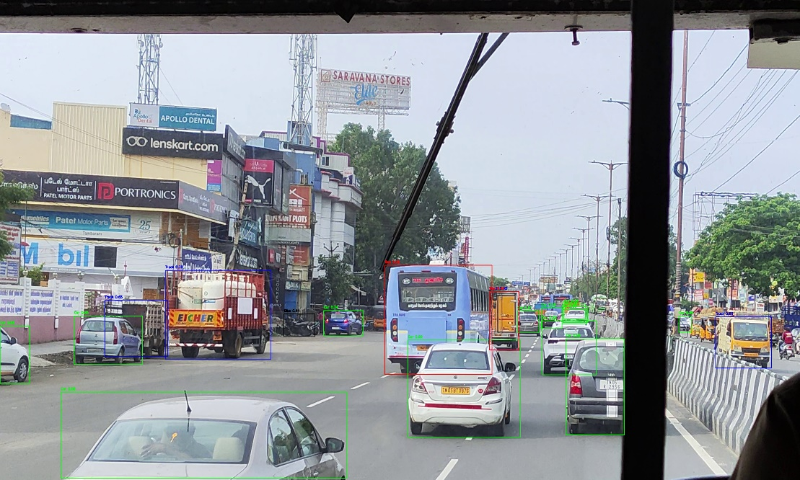
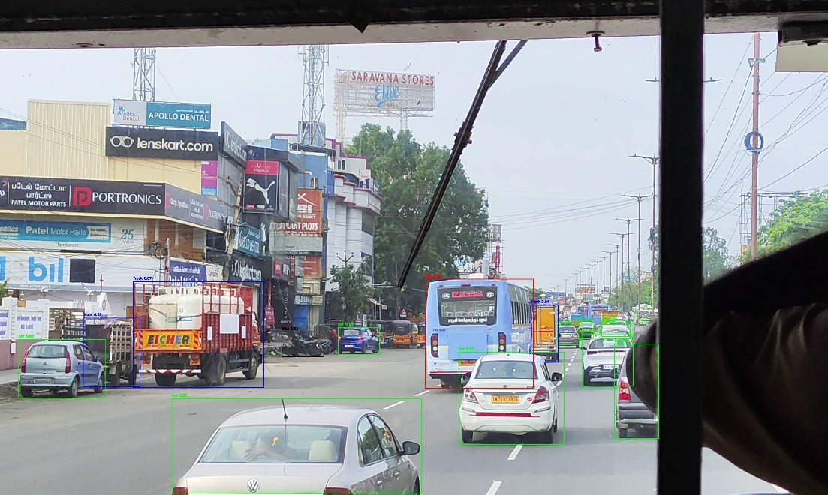
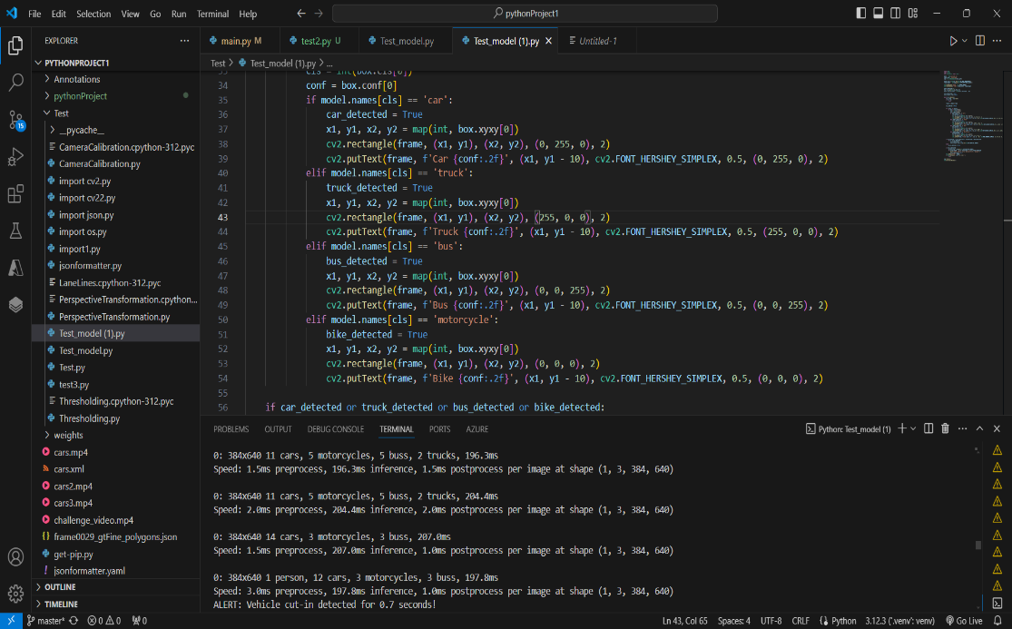
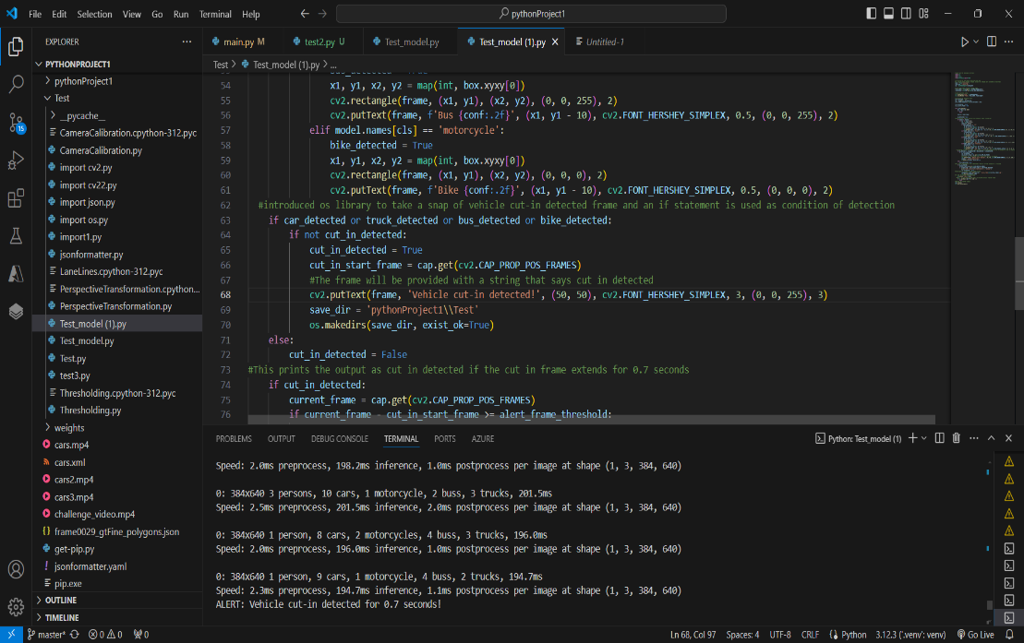
Results
These footages were taken from Sanatorium, Chennai
These footages were taken from Sanatorium, Chennai

Slide 9
Process Flow
Conclusion
Cut-in detection is crucial for autonomous driving and collaborative robotics, relying on advanced sensors and predictive analytics.
Multiple sensors like cameras, radar, and lidar enable detection of subtle traffic changes signaling potential cut-ins.
Teammates enhance detection with predictive abilities, clear communication, and coordinated response strategies.
The synergy between technology and teamwork ensures swift and safe reactions to dynamic traffic scenarios.
Overall, this approach improves system safety and efficiency in complex environments.

Slide 10
THANK YOU

